Slide 1
BC Code Review Final Presentation
Christina Nguyen, Sarah Ramazani, Michael Bloomquist, Travis Lamb

Slide 2
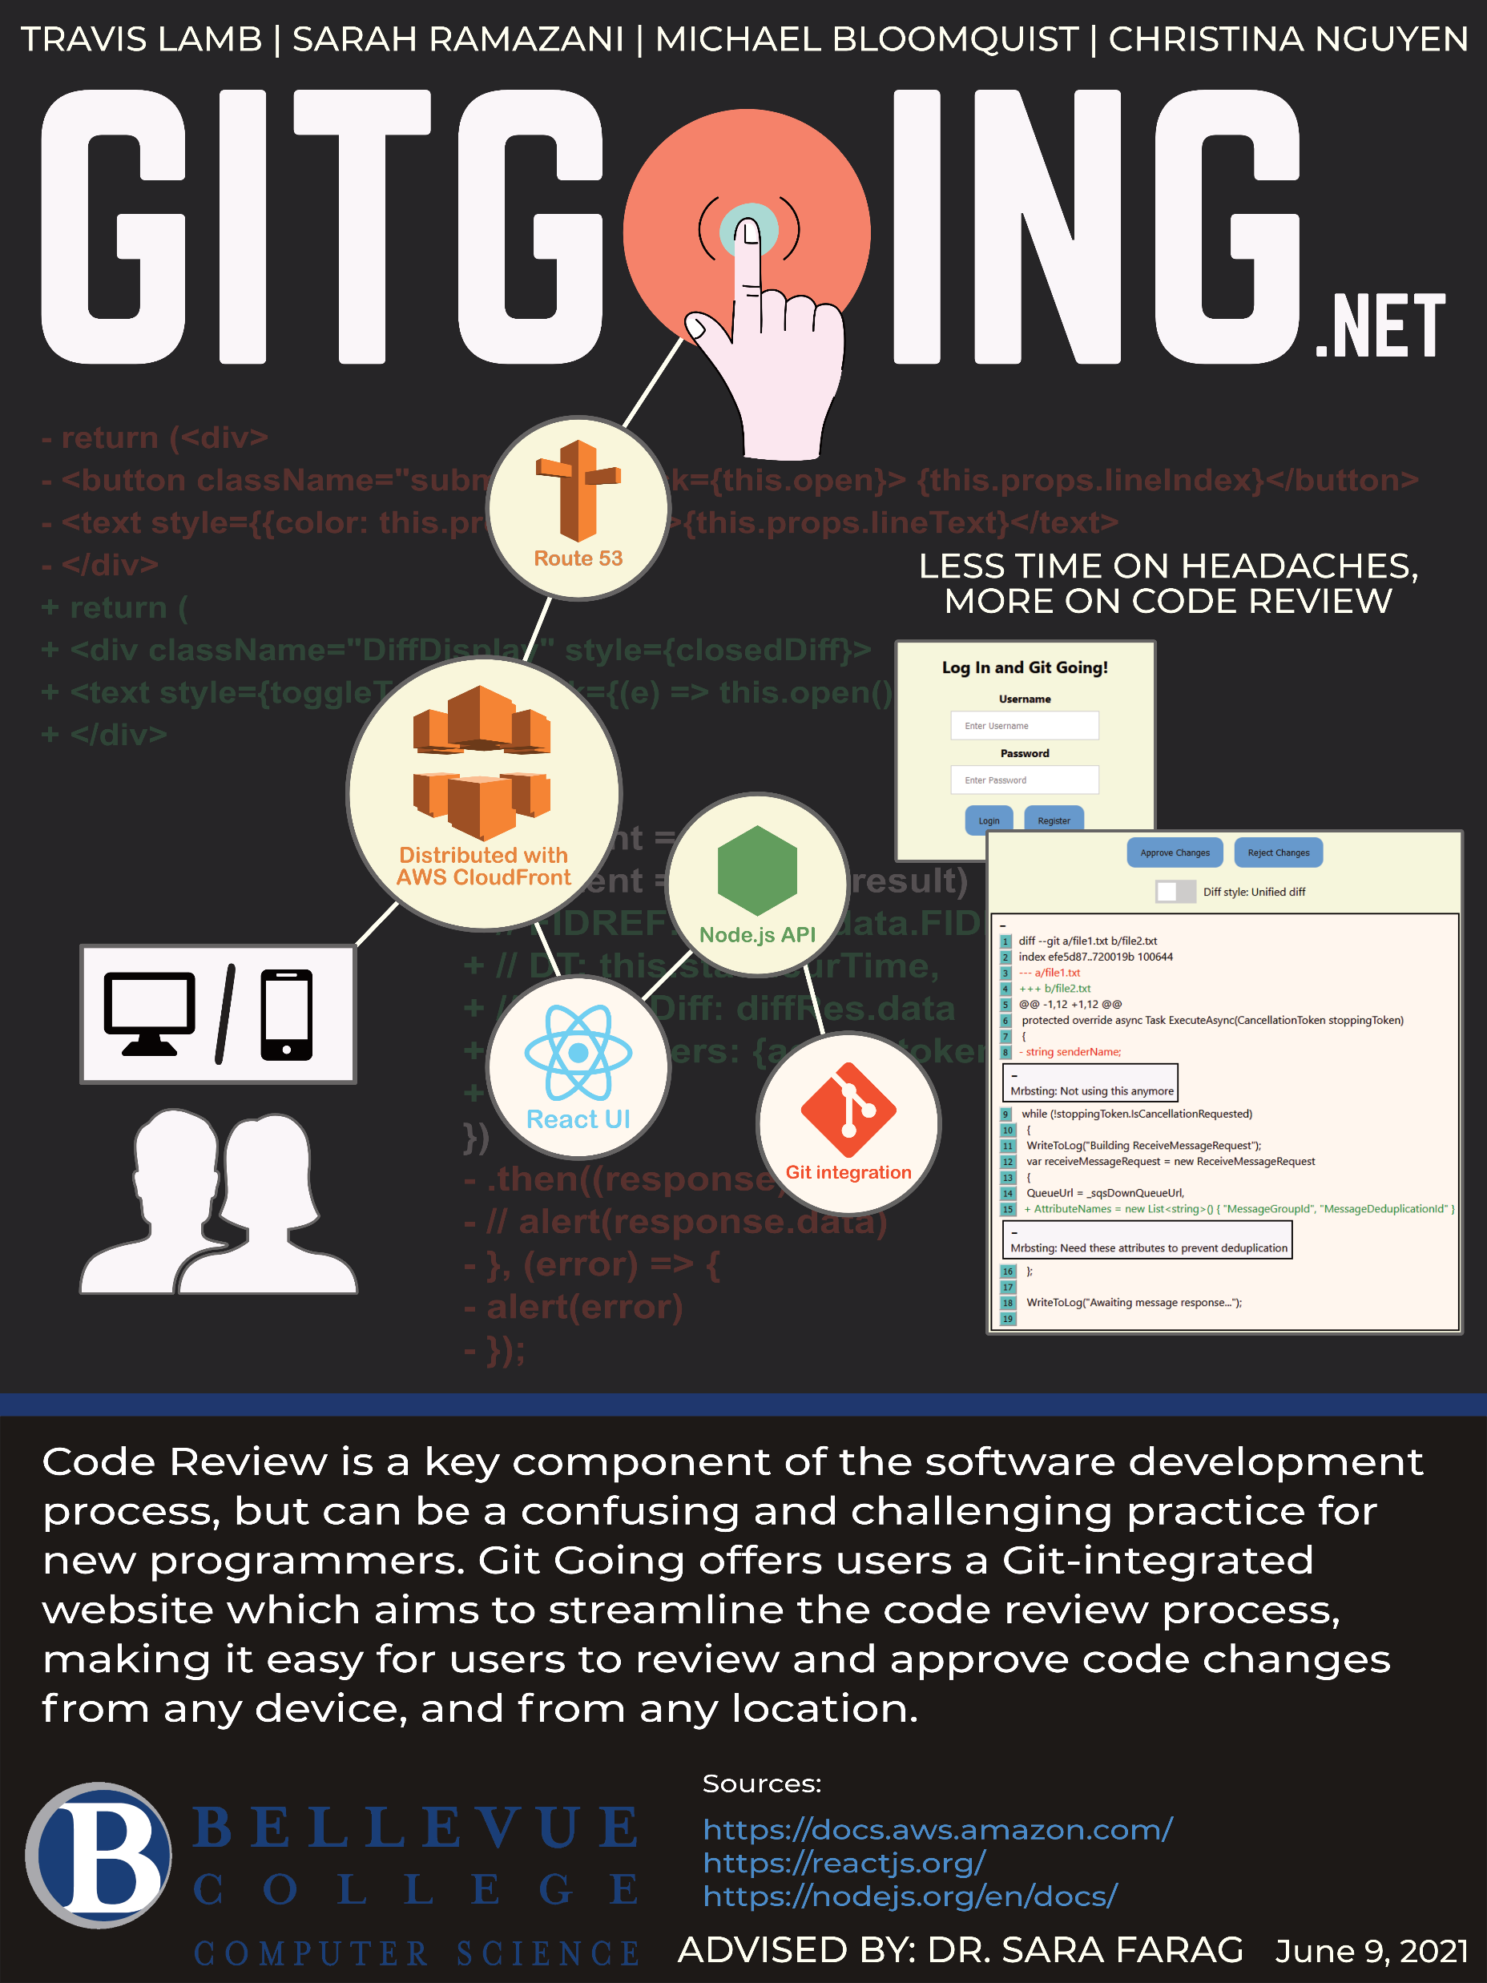
GitGoing architecture poster, designed by Christina Nguyen and Michael Bloomquist

Slide 3
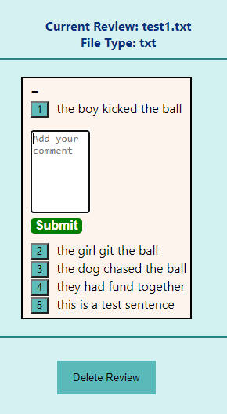
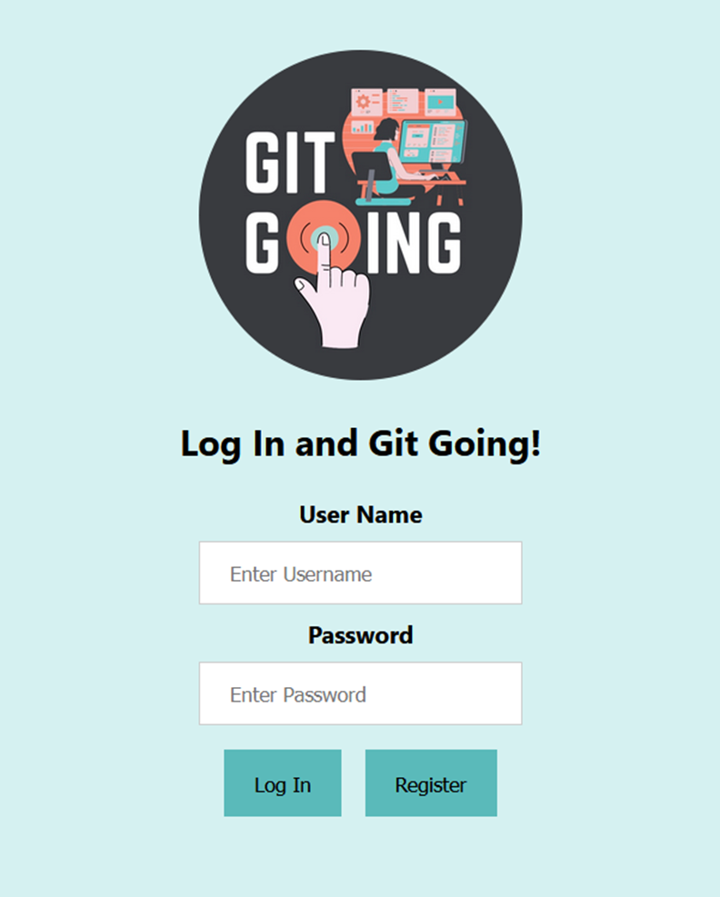
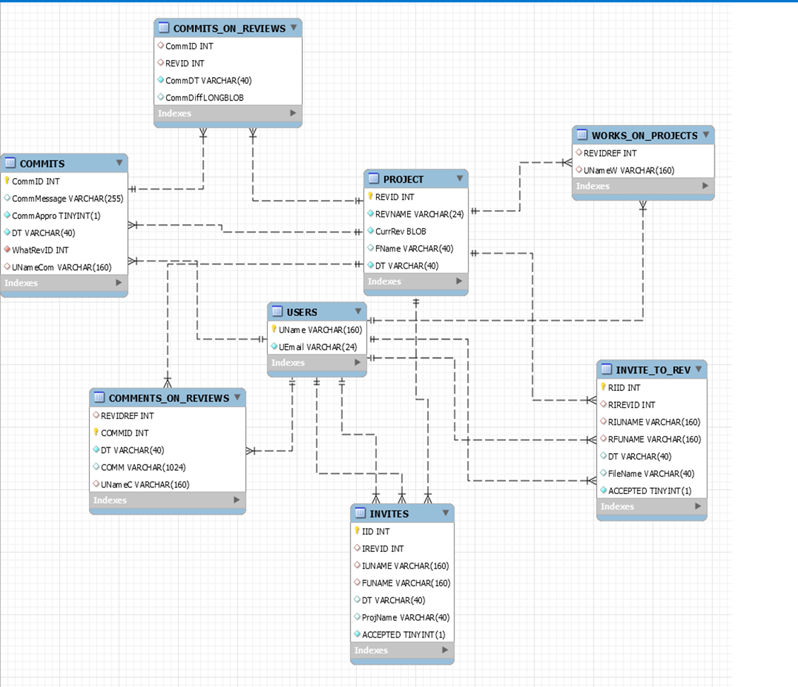
Where we were
Authentication System
Simple Email Service
Simple Queue Service
Database System
File Contents
User Information
Inline Commenting

Slide 4
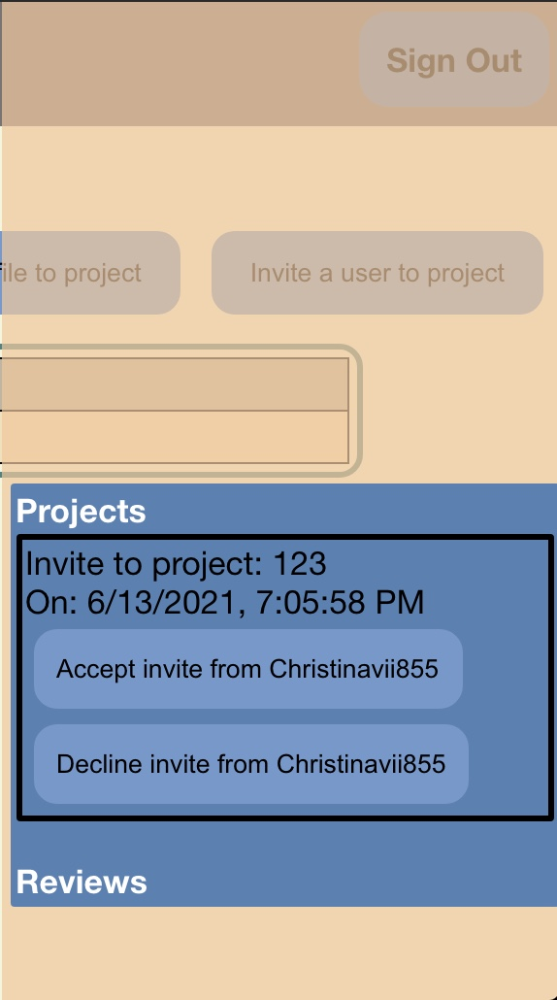
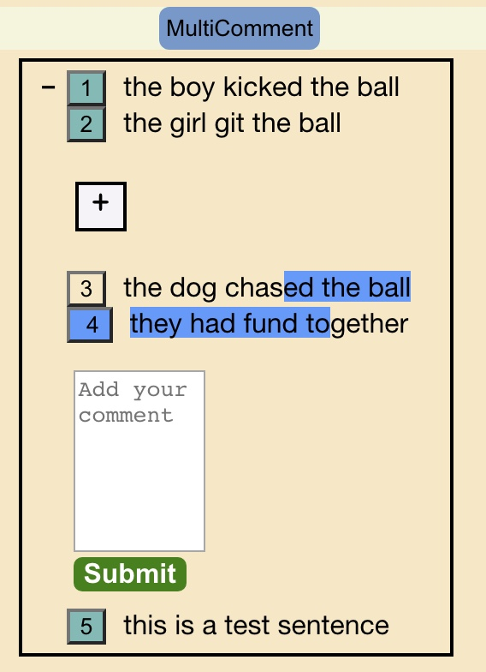
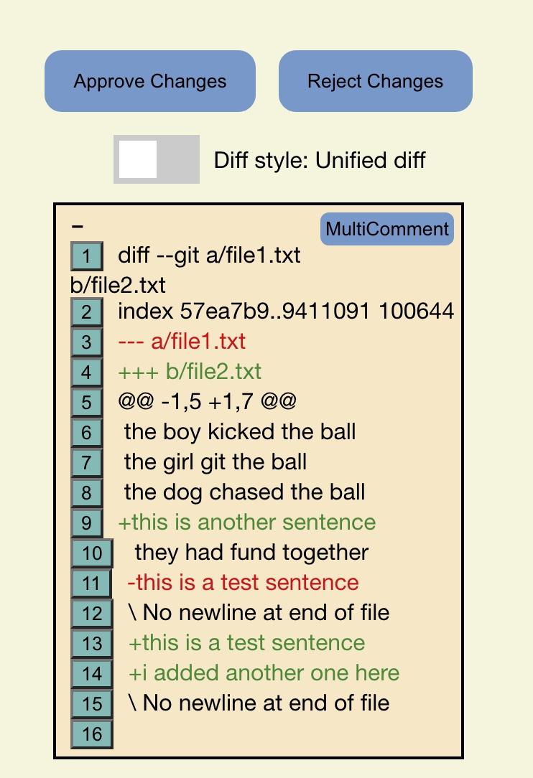
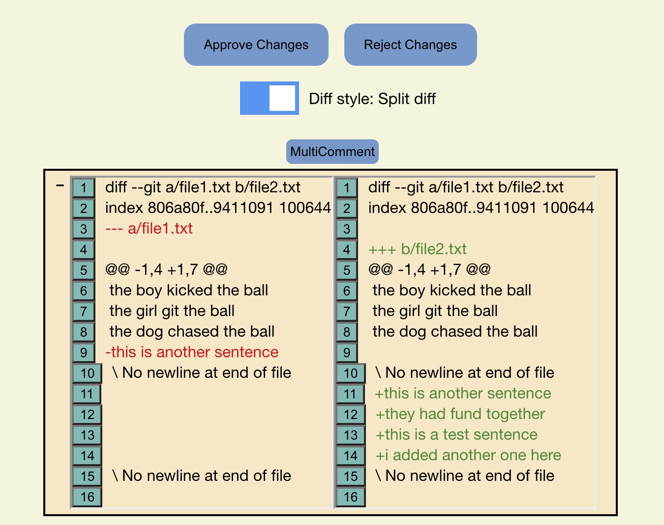
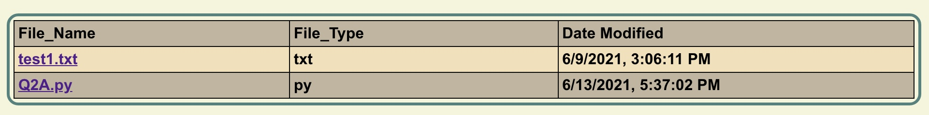
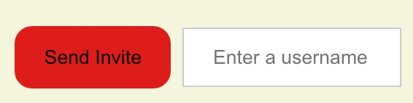
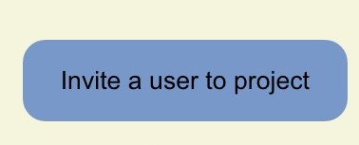


Where we are
Automatic retrieval of diffs when a file is updated
Implementation of the approval/rejection system for reviews
Implementation of file history for projects
Multiline commenting
Notifications

Slide 5
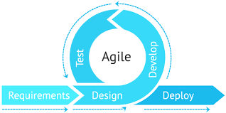
How we got there
Understanding of React components
Storing Comments in Database
Flask app to retrieve diffs
CSS Redesigning
Trial and Error

Slide 6

What did not work
Building the diff retrieval tool using JGit
Expanding the file types for reviews to nonstandard file types
Consistency into splitting diffs into full context or minimal context
Site adaptation to all types of resolutions
Integrating our notification system into the live build

Slide 7

Biggest accomplishment
User Registration and login system
Authentication system
Database system
File upload and display of the file history
Inline and multiline commenting
Diffs retrieval and display
Approval and rejection system for reviews
Notification system for the user invite
Hosting a full stack web application

Slide 8

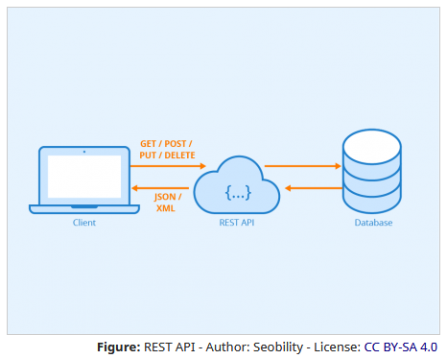
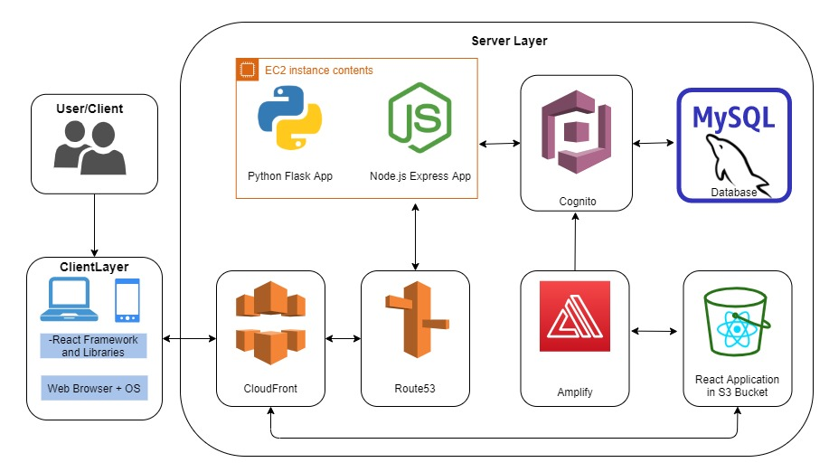



Biggest Challenges
Hosting
Learning new technologies
React
Amazon Web Services (AWS)
APIs
CSS
Overwhelmed ourselves at times

Slide 9
Things we would do differently
Utilize CI/CD in development
Use Redux or similar for state management
Use more React UI libraries rather than creating all our own components
Get rid of python app, node.js app serves all needs
Use more AWS services (such as S3 or Lambda) over some of our current implementations
Keep code cleaner from day one, to avoid refactoring six months in
Better project planning and management of time

Slide 10
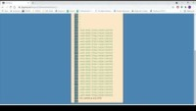
Final Demo for GitGoing
Register an Account
Make a Project
Add Files
Invite Users
Start Reviewing!

Slide 11
GitGoing’s Final Conclusions
What an experience
How far we’ve come
Biggest takeaway
What’s next?
Fin

